Slide 1
AIOPs foundation Test exercise
Anil Kumar (aiopsuser6)

Slide 2
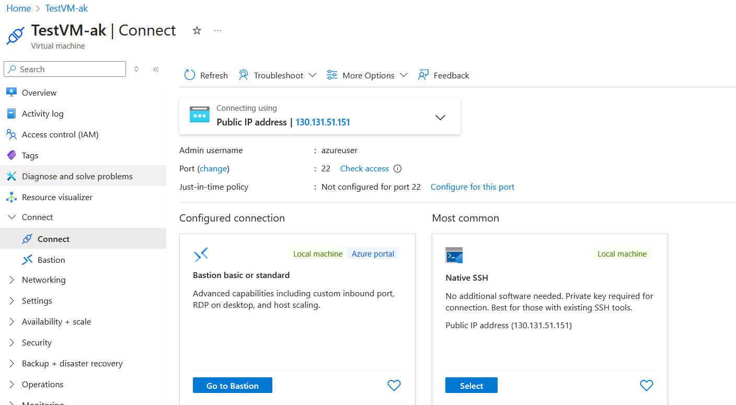
VM Created and boarded to ML

Slide 3
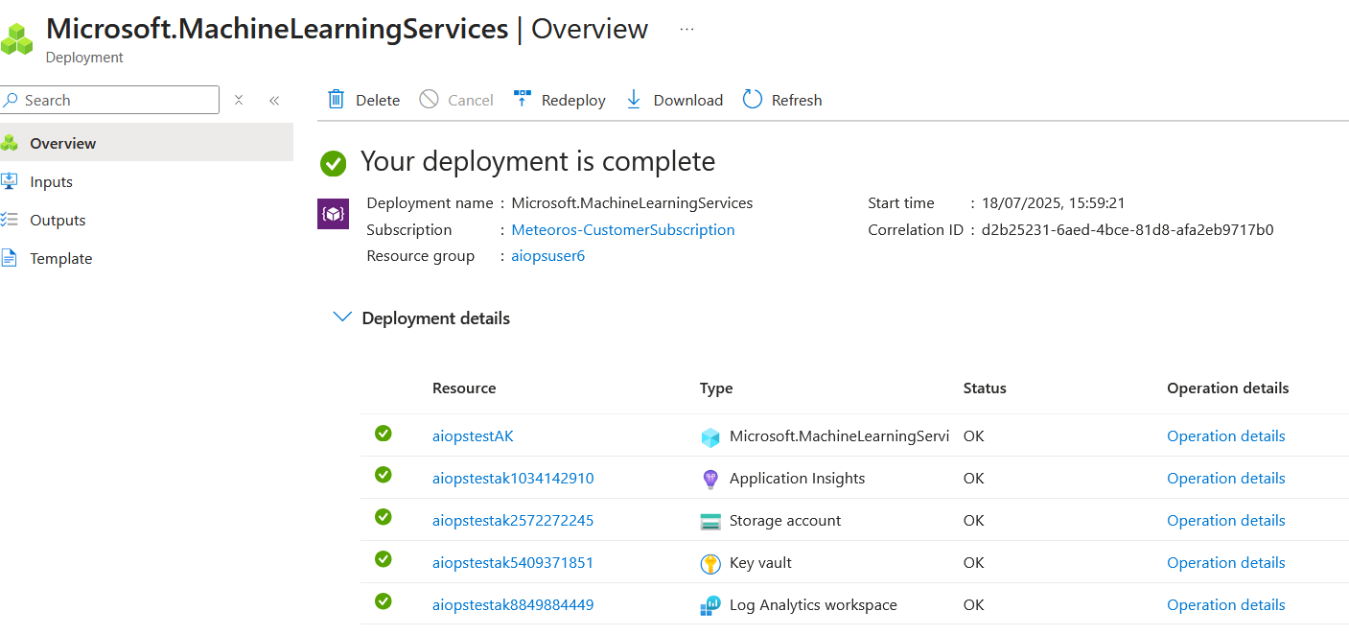
Workspace created

Slide 4
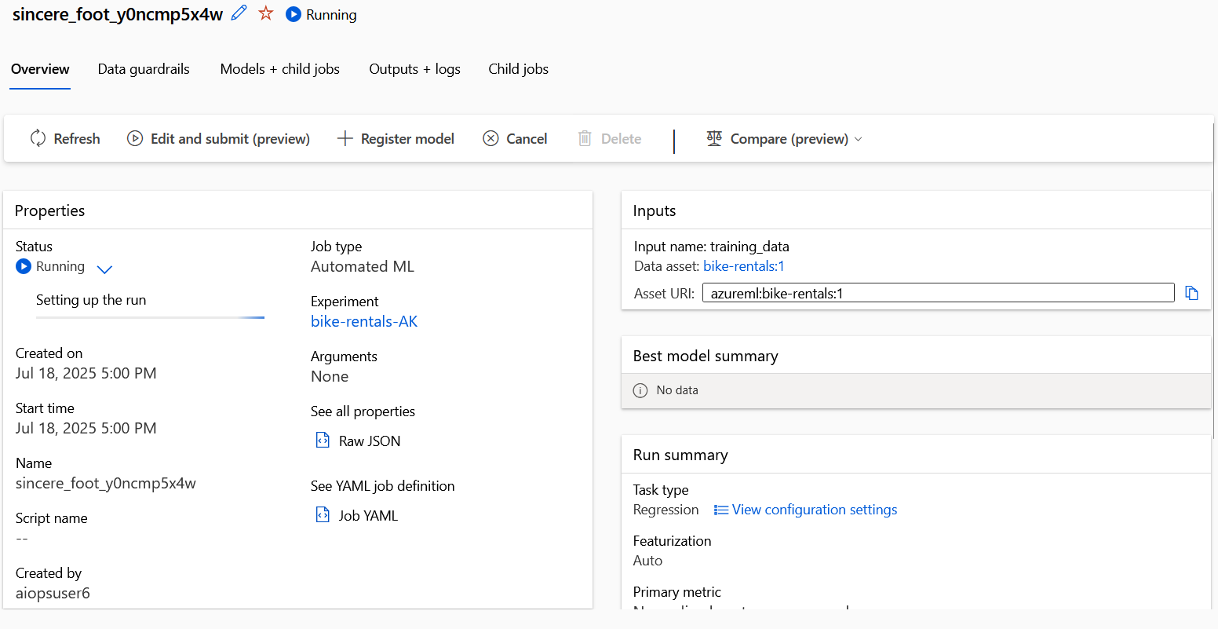
ML job to train a model

Slide 5
